Slide 1

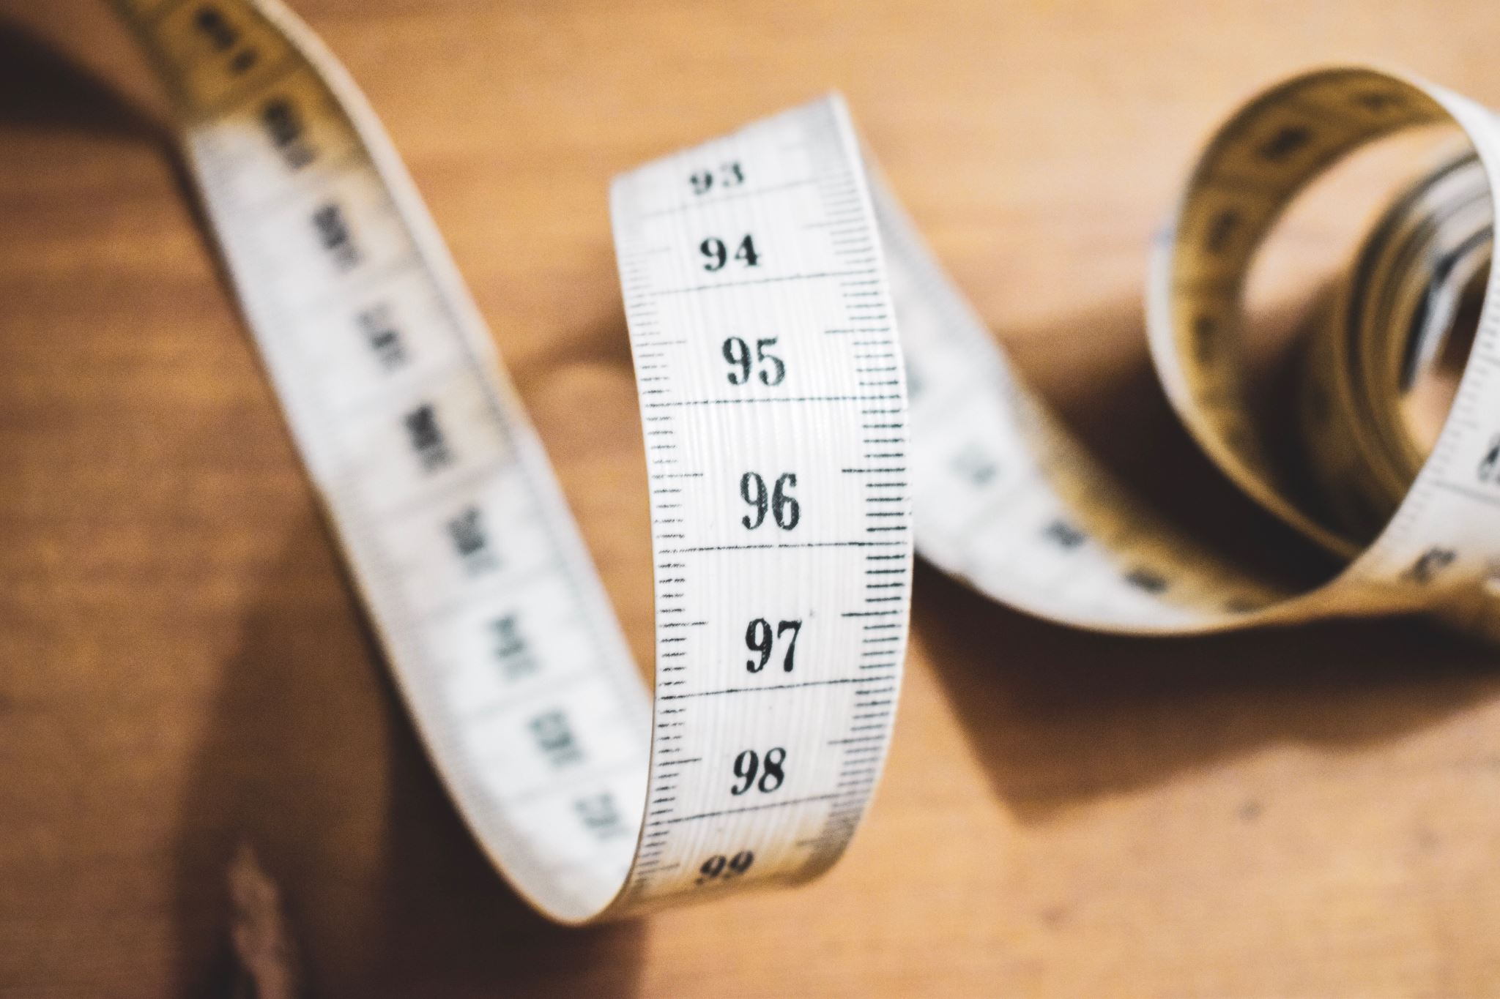

Building a Predictive model for Body Fat Percentage
Goal :
Build a model to predict the Body Fat Percentage using only simple measurements that can be taken only using a scale and tape. Variables with further calculation are excluded.

Slide 2
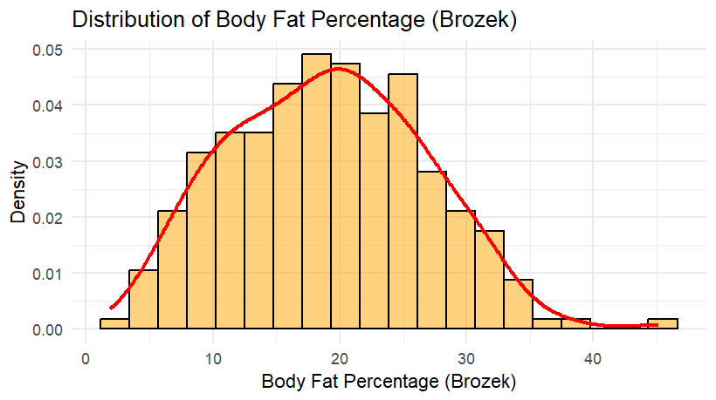
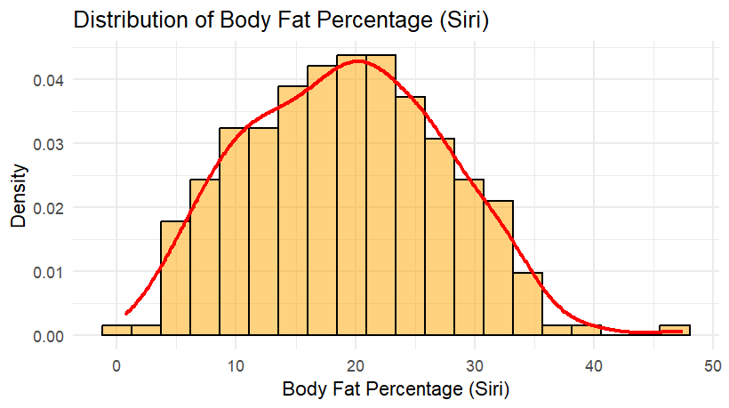
Both distributions appear similar

Slide 3
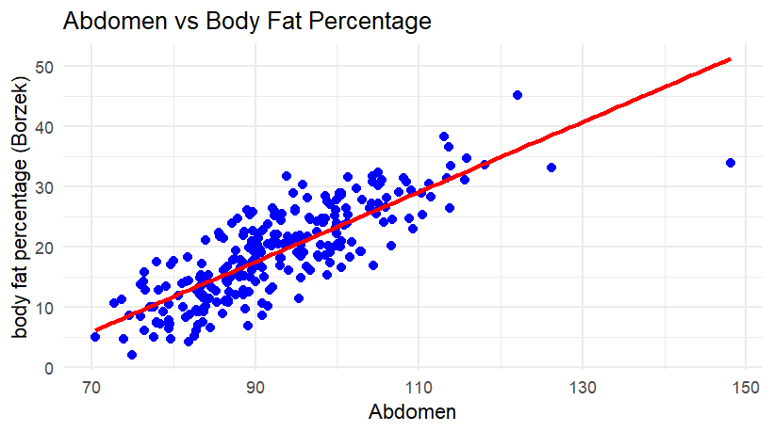
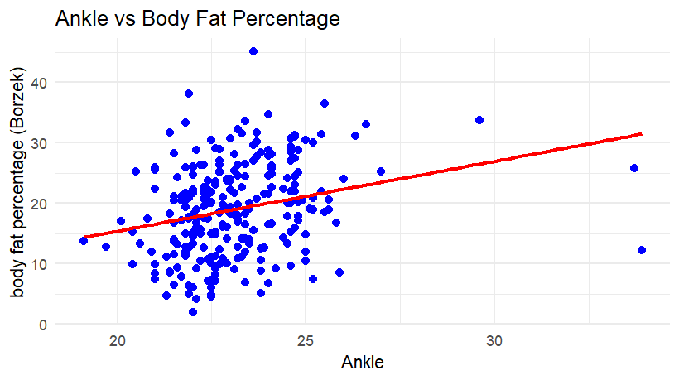
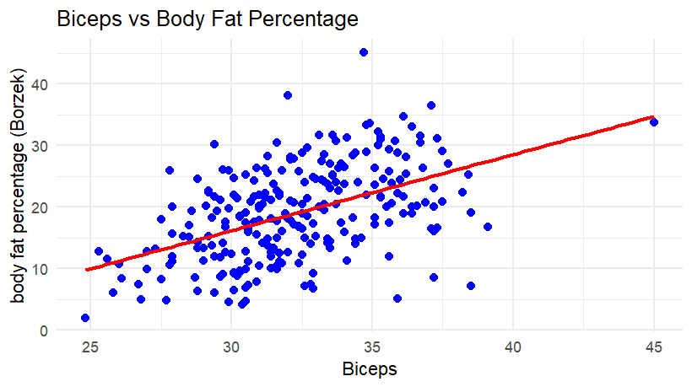
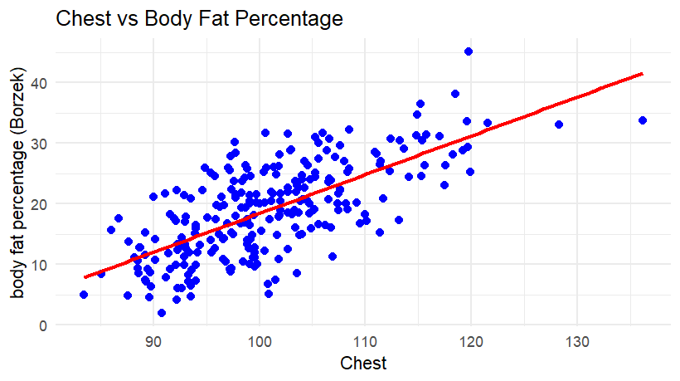

Slide 4
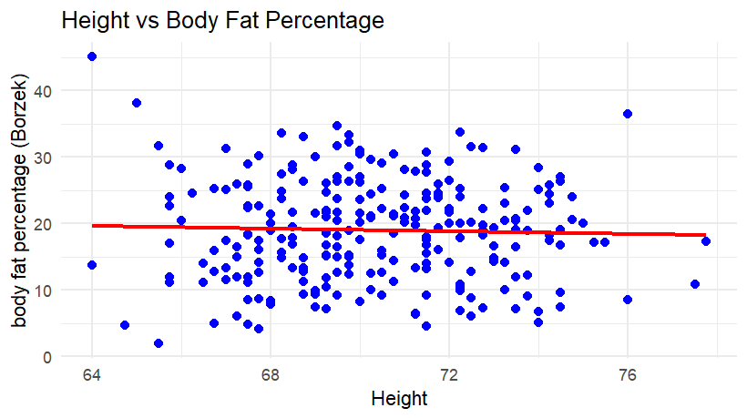
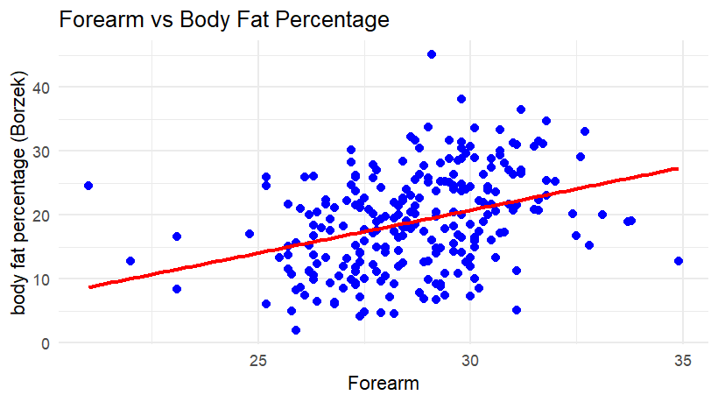
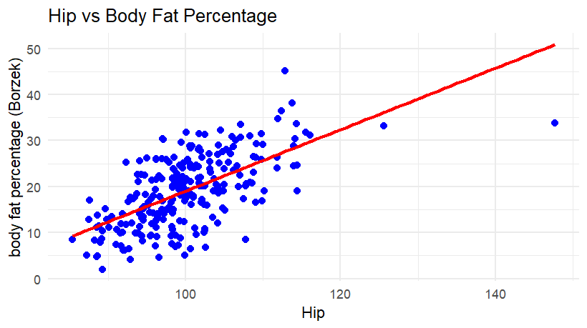
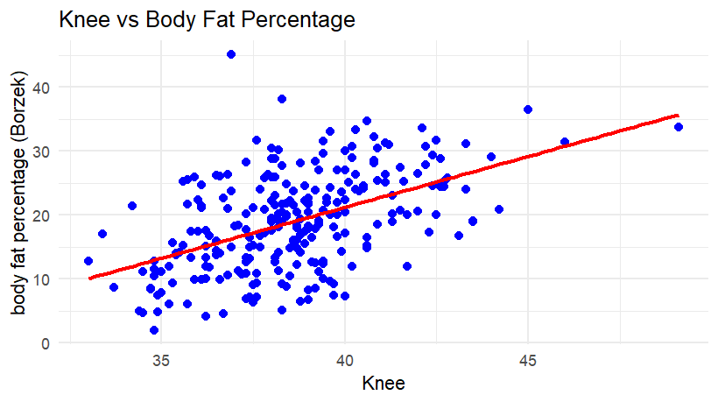

Slide 5
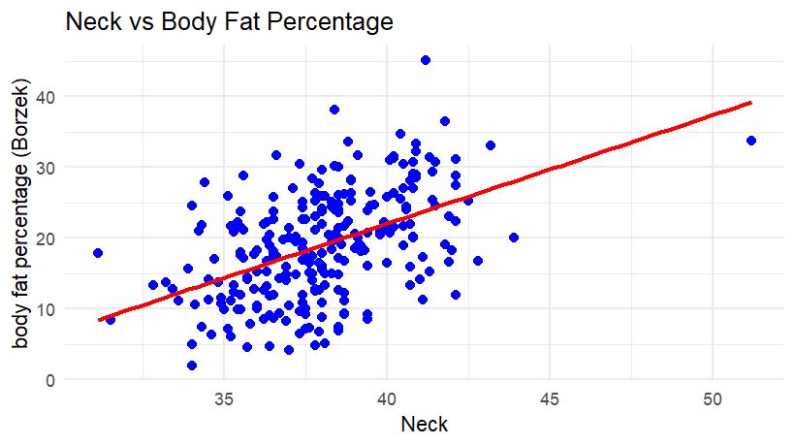
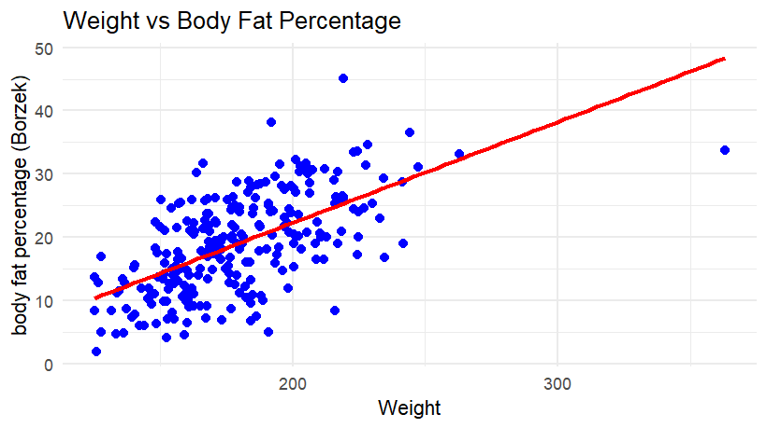
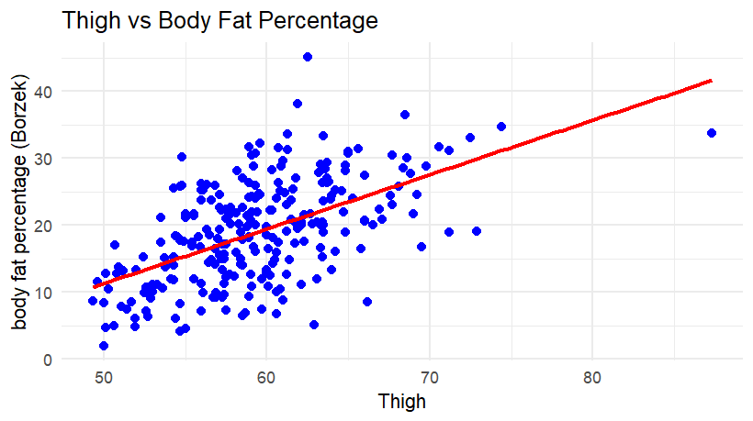
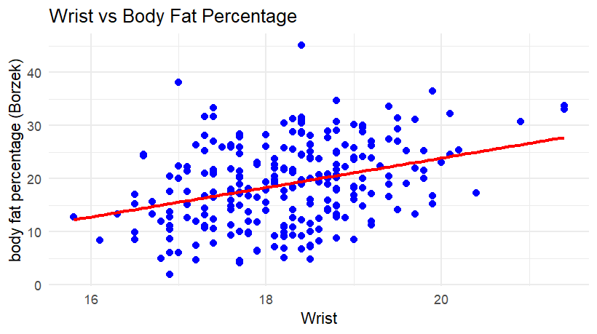

Slide 6
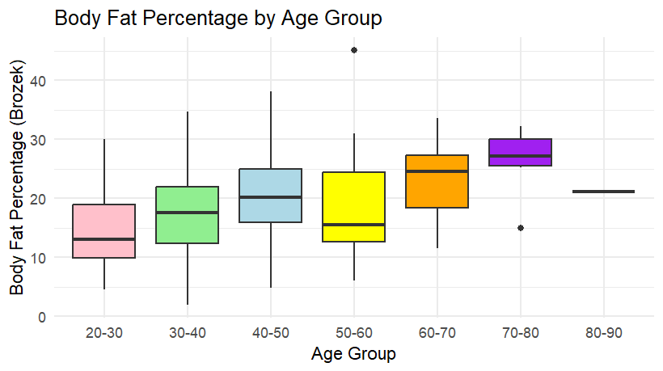
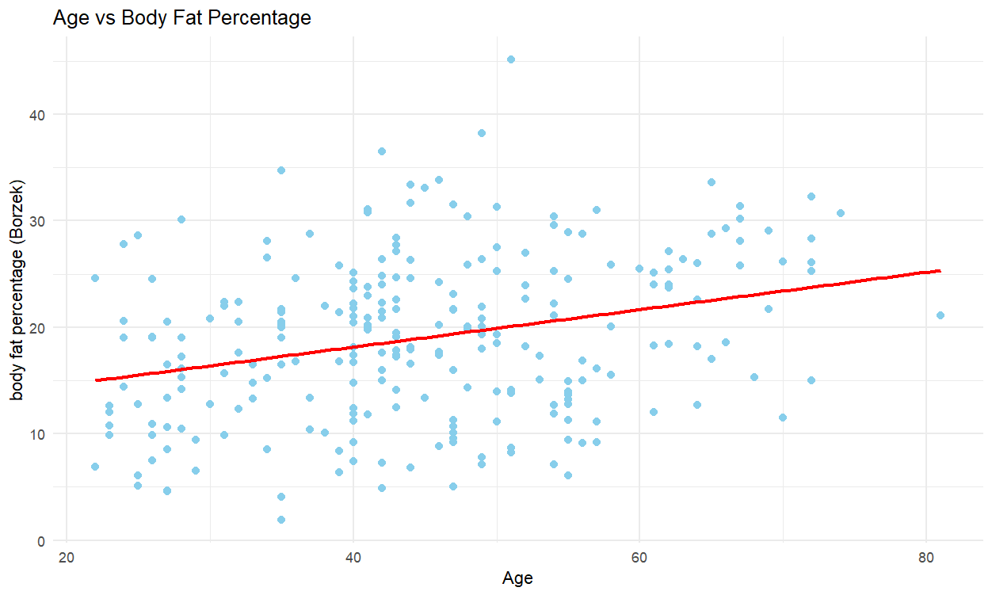

Slide 7
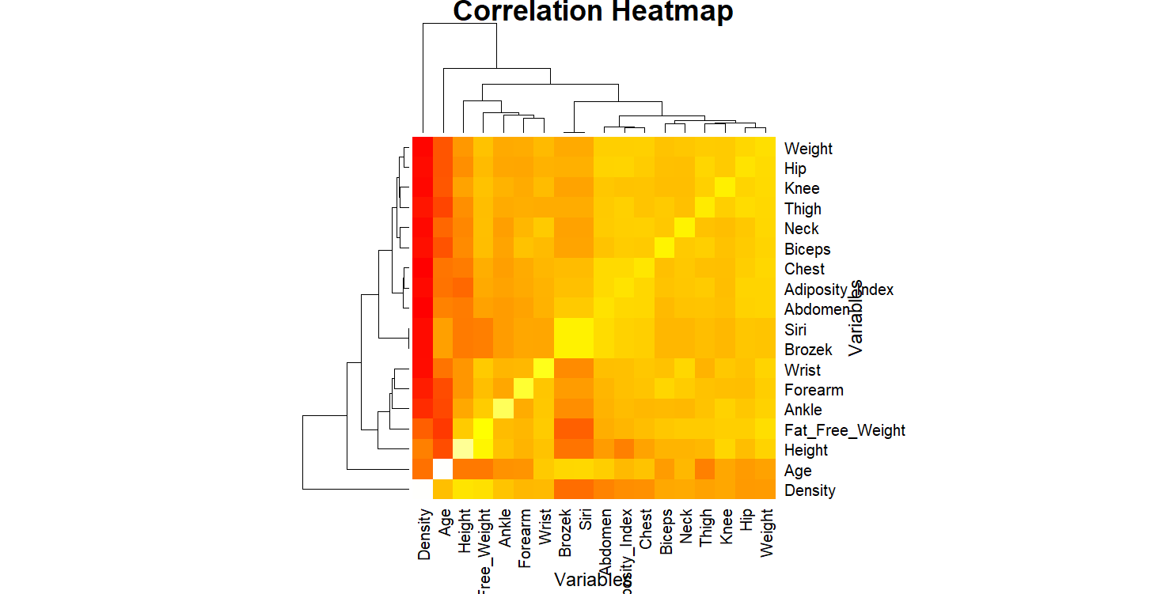
Density is highly
Correlated with Body Fat
Percentage.
Also, it appears that Age, height,
weight , forearm, and wrist are
correlated with the Body Fat
Percentage.

Slide 8
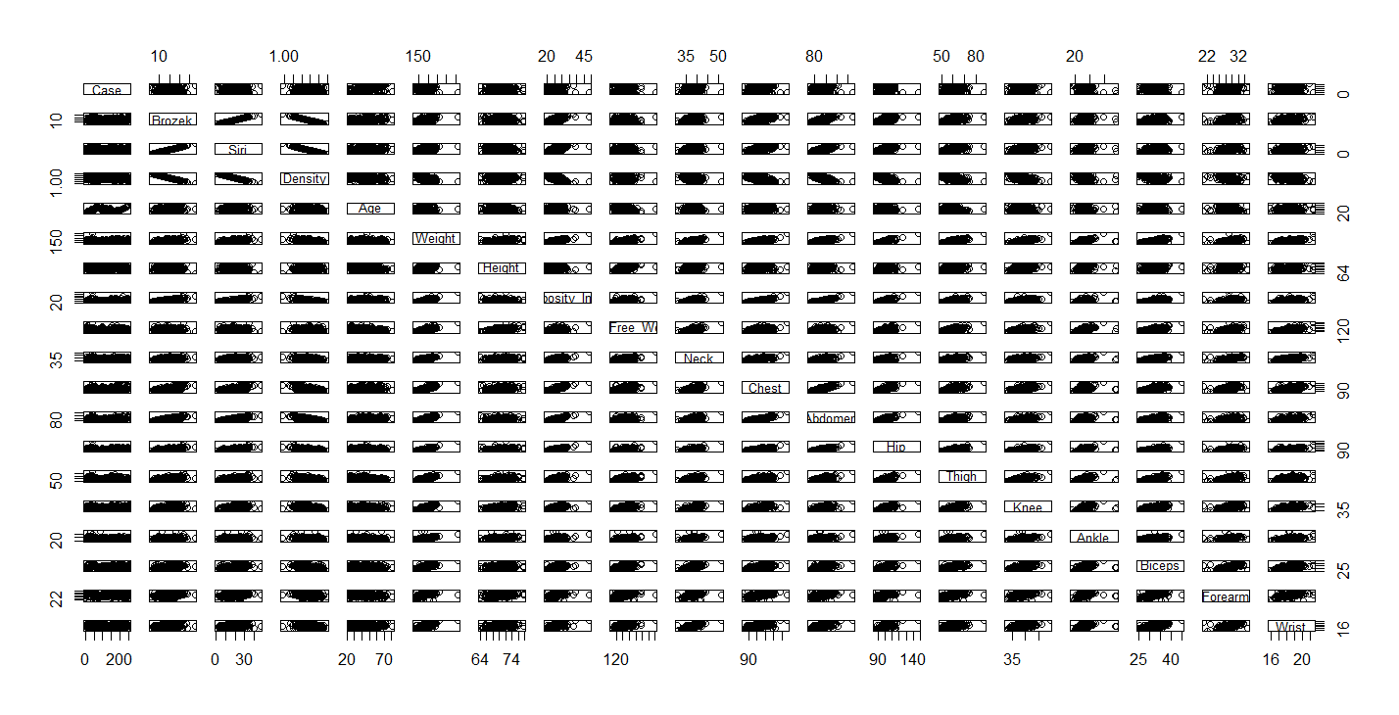
Density has a strong negative relationship with body fat percentage.
Also, many predictor variables are correlated to other predictor variables.

Slide 9
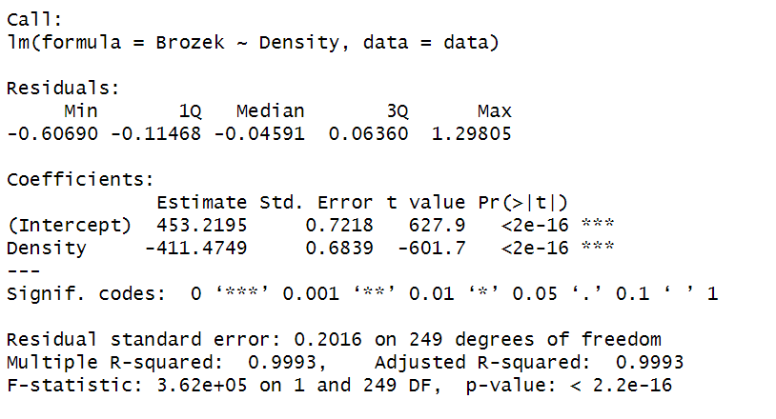
Linear Model 1 Using only Density
This is a very strong model.
Density alone can explain the 99.93% of the
Body Fat Percentage Data.

Slide 10
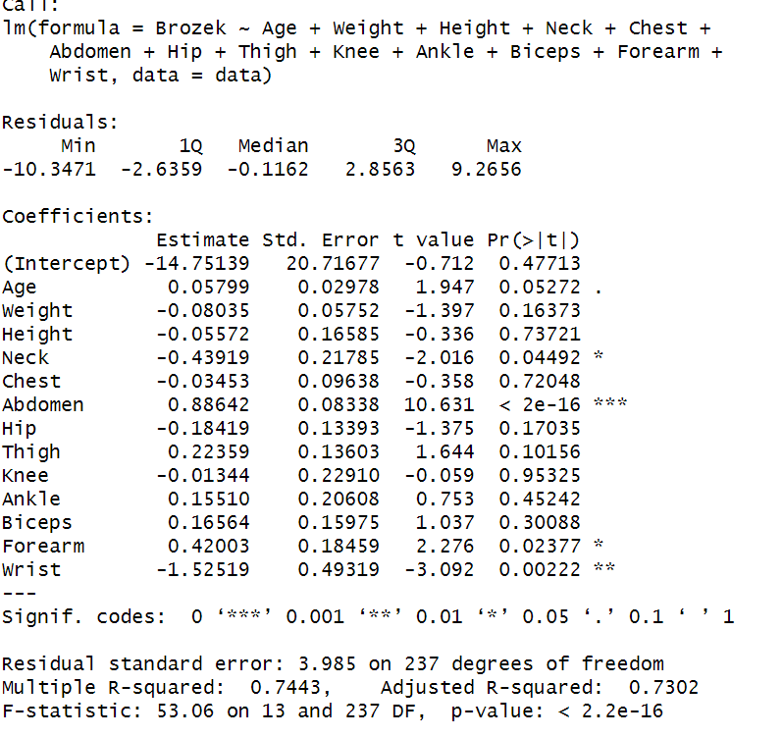
Linear Model 2 using 13 Variables
This linear model without the density has
Been able to explain 73.02% of the data
which is moderately good, considering the
fact that we did not use highly influential
predictor variables like density, Fat-free
Weight and Adiposity Index.
This Model uses 13 variables.
Can we make it simpler?

Slide 11
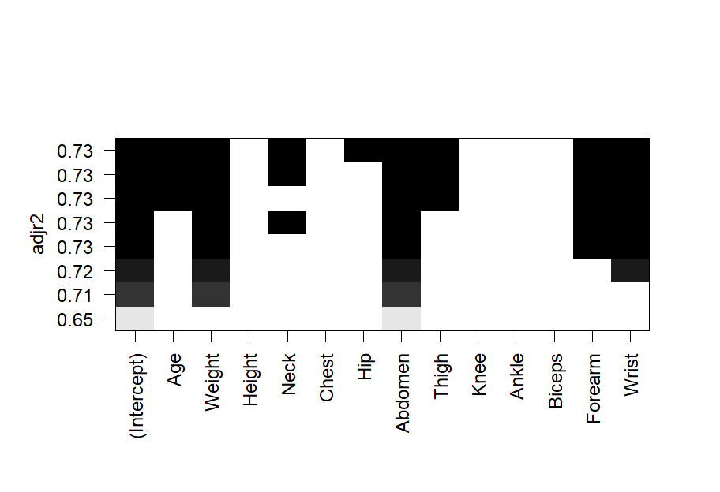
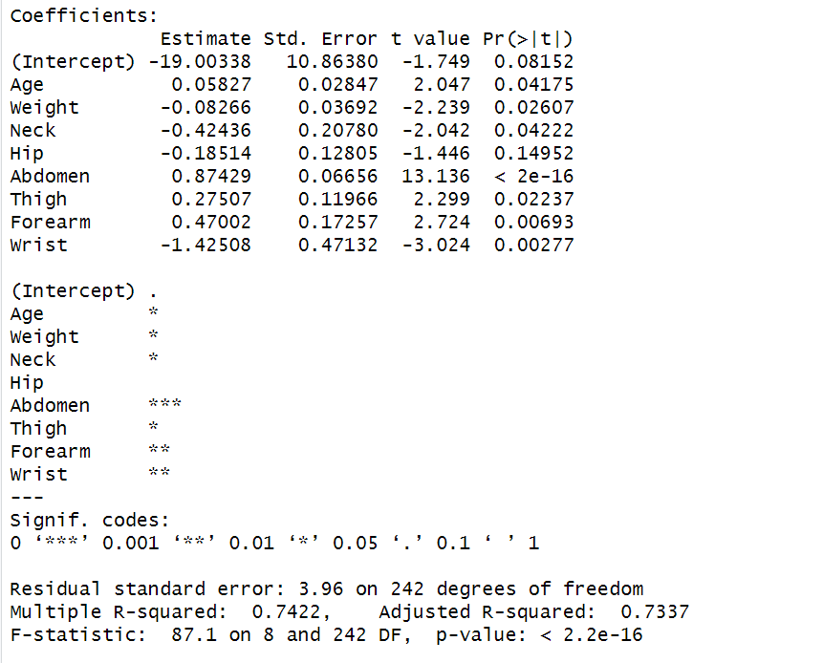
Subset regression and making the model 2 simpler
We can see we can get a 0.7337 adjusted R^2 value by using variables Age, Weight, Neck, Hip, Abdomen, Thigh, Biceps, Forearm, and Wrist.

Slide 12
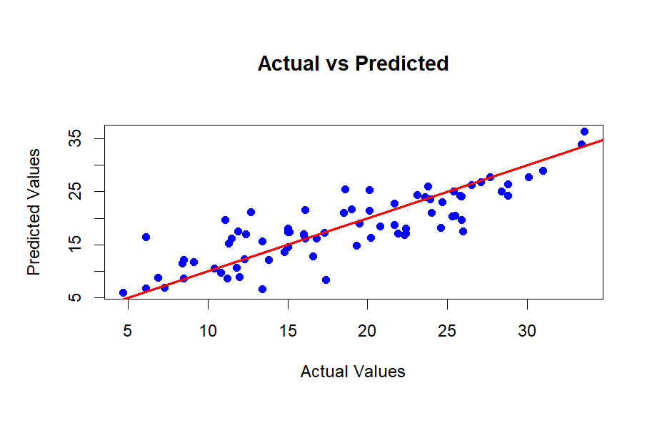
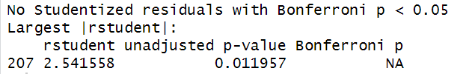
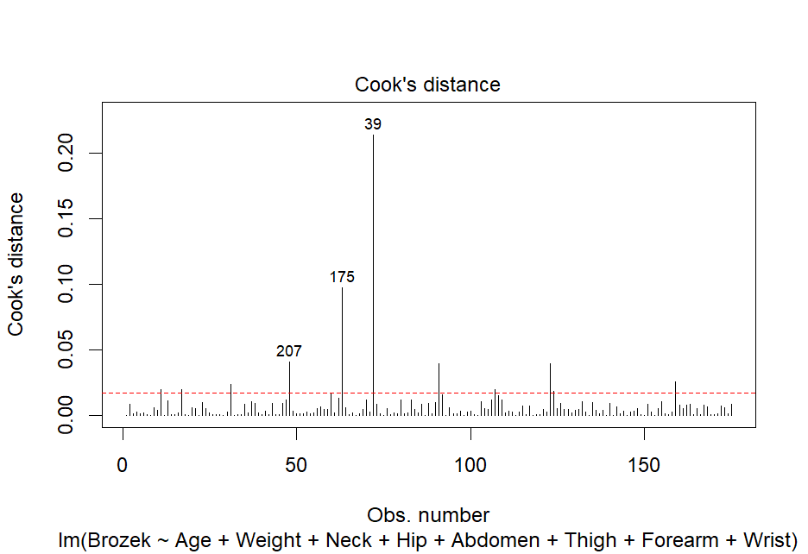
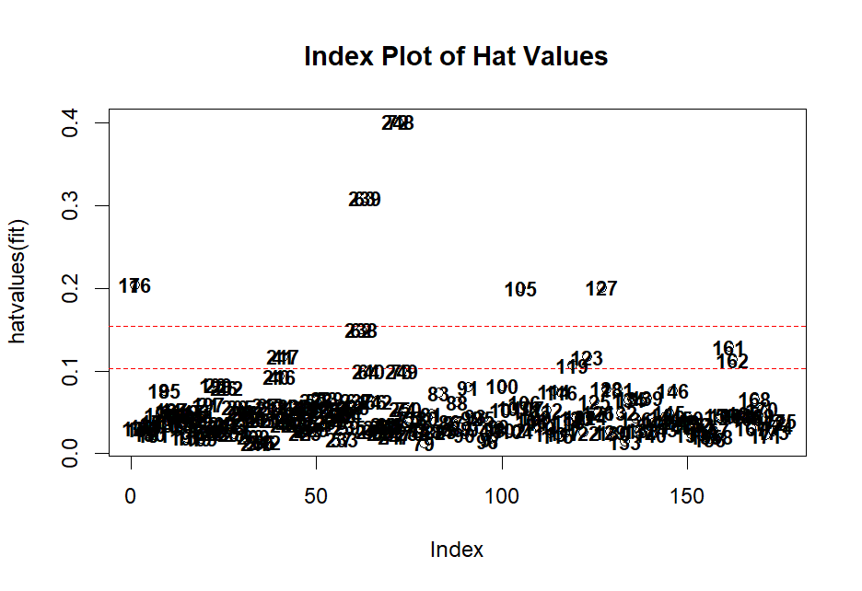
Test R^2 for lm model 2 is 0.7099
Can multicollinearity play a role as many variables are highly correlated ?

Slide 13
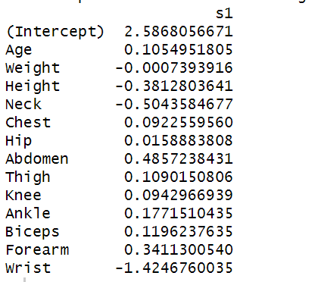
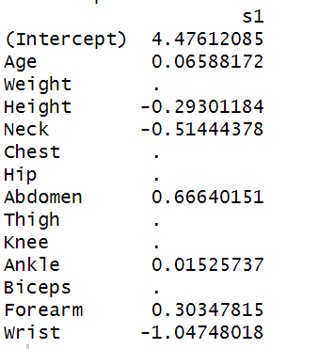
Model 3. Ridge Regression
Model 4. Lasso Regression
Coefficients for Ridge Regression at
Best lambda = 0.63386
Coefficients for Lasso Regression at
Best lambda = 0.16836
Test R^2 = 0.7181
Test R^2 = 0.6990

Slide 14
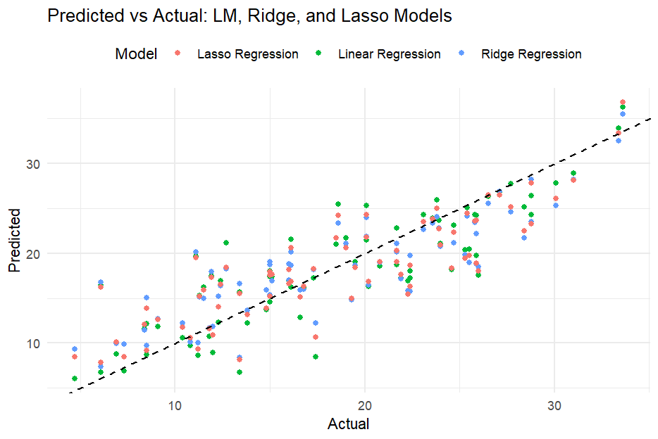
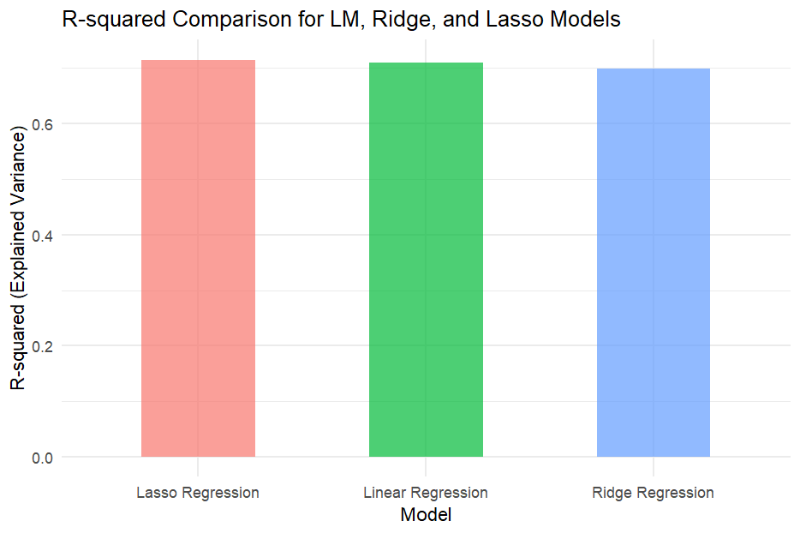
Models Comparison

